Slide 1


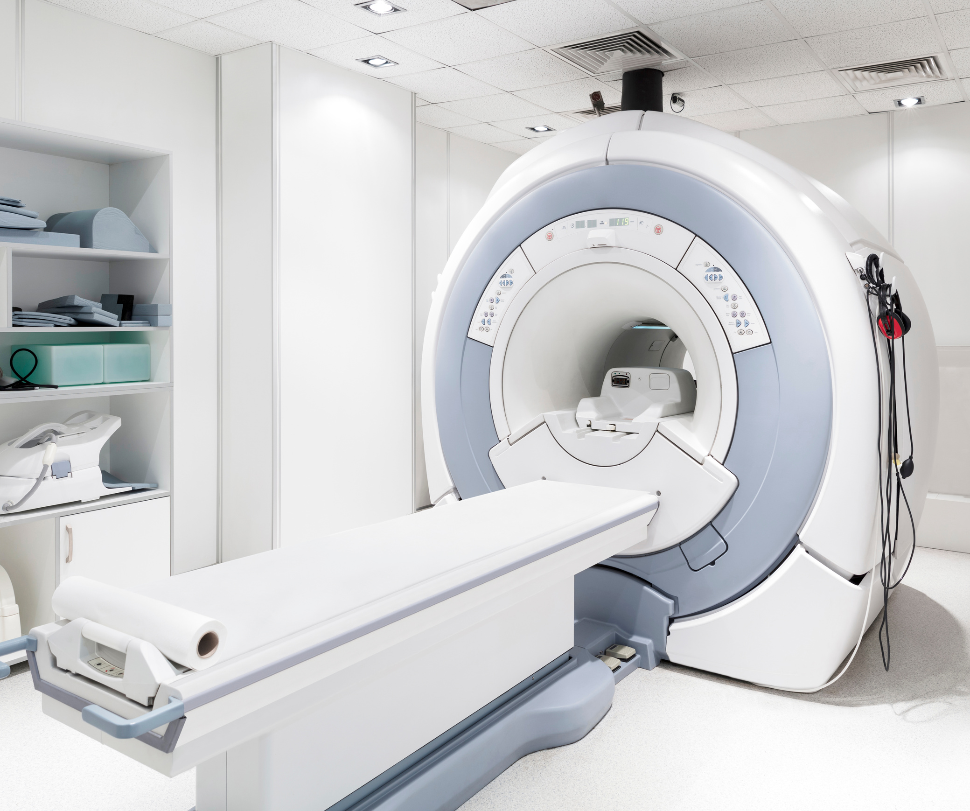
Information And Communication
Technology
Capstone
Project
Mri Impression
Assistant
Name : Vrajkumar Nandwana
Enrollment : 92200133018
Project Guided by : C.D. Parmar
Class : ICT Sem 7 TK1

Slide 2
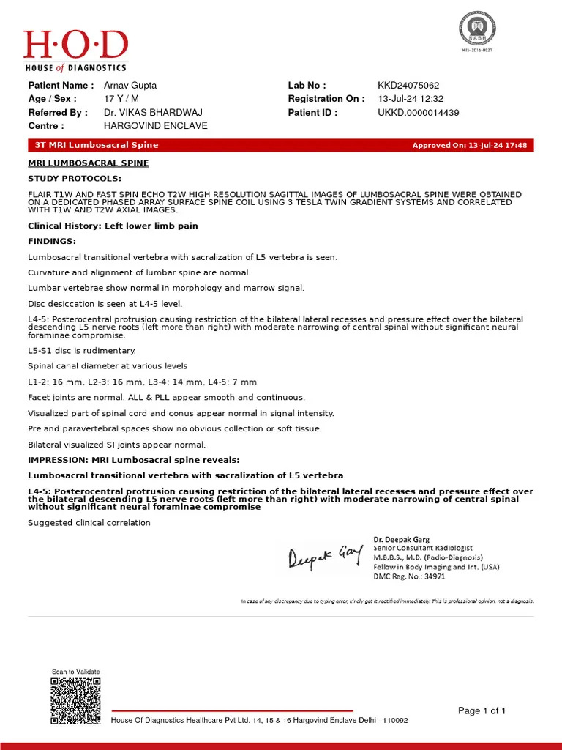
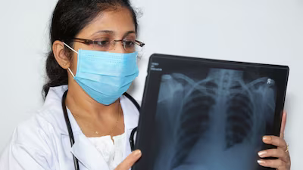
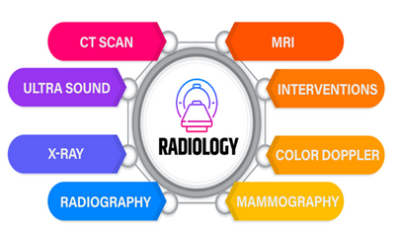
The Challenge in Radiology: Manual Impression Generation
Radiology reports have two parts:Getting Scan and imaging then a detailed Findings and a concise Impression.
Generating the Impression is critical, time-consuming, and cognitively demanding for radiologists.
High workload, need for accuracy, and potential for human error.
With just approximately 20,000 radiologists serving a population of over 1.4 billion, India is confronted with an alarming ratio of one radiologist for every 1,00,000 individuals, far below global healthcare standards
Diagnostic Services

Slide 3
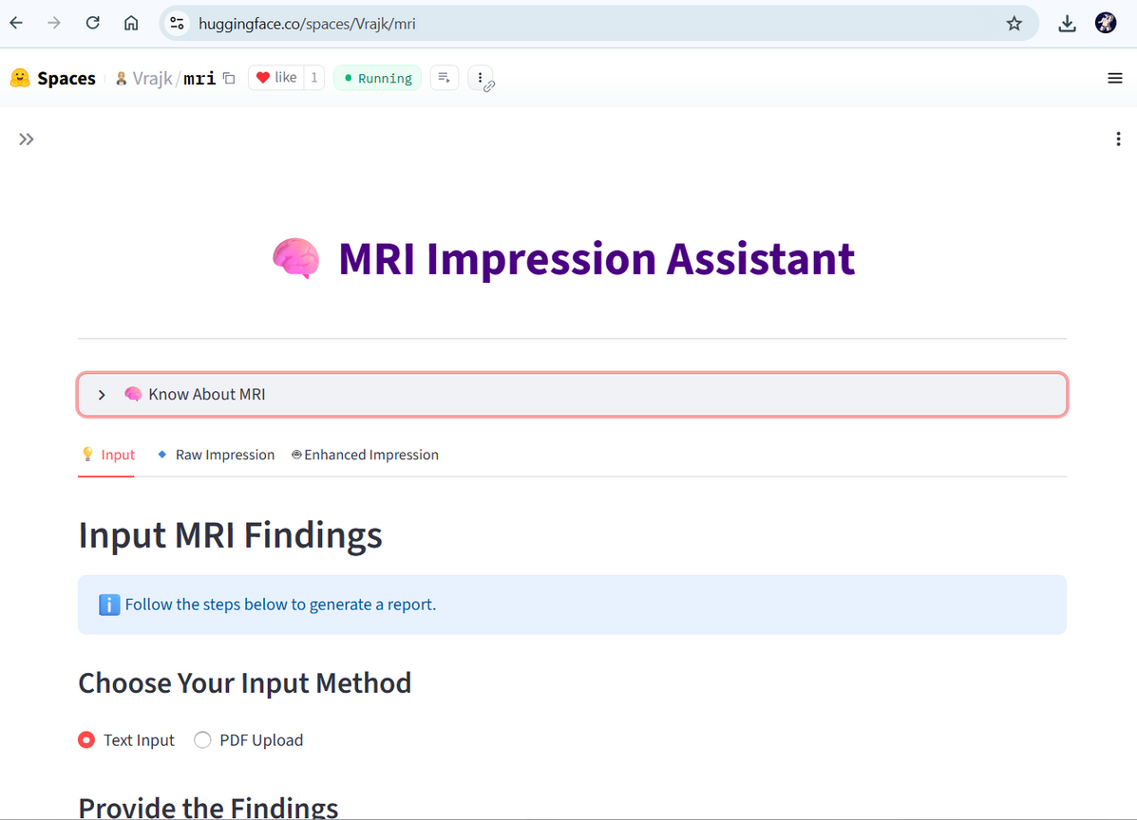


The MRI Impression Assistant
To develop an intelligent assistant that automates and enhances the generation of MRI impressions, improving efficiency and consistency in radiology reporting.
Key Objectives:
Automate Draft Impression: Generate initial summaries from detailed findings using specialized AI.
Enhance with Expert AI: Refine drafts into professional-grade impressions with advanced LLMs.
Support Flexible Input: Accept findings via text paste or PDF upload.
Ensure Robustness: Validate input to process only relevant medical data.

Slide 4
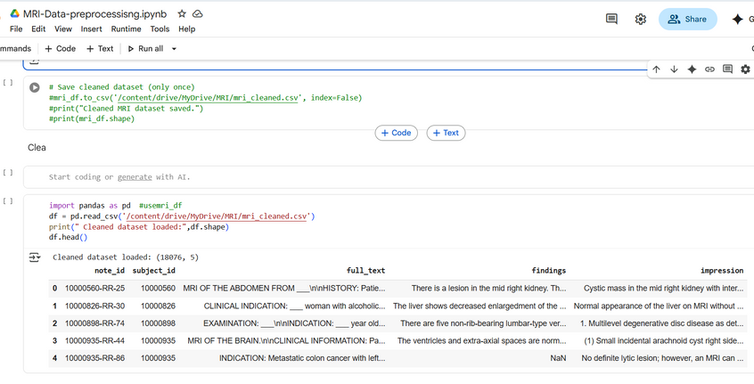
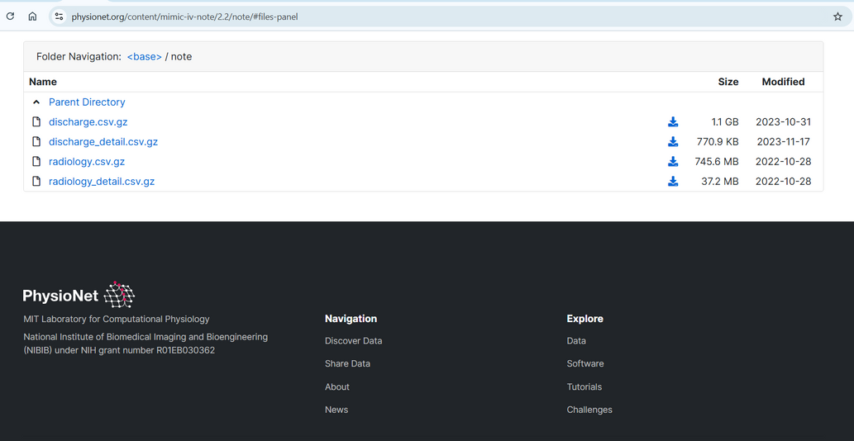
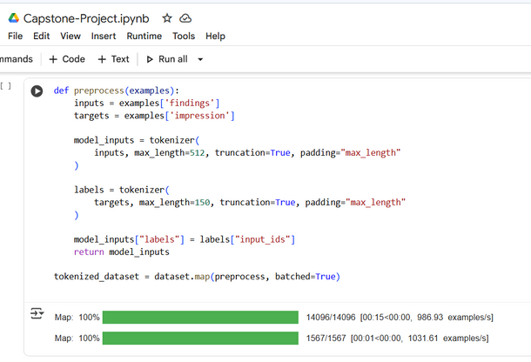
Data Collection & Processing
The data of mri is hard to collect , the data is private and less publicly available dataset is there , and even if it is there then they are of Images of a particular like brain etc
The radiology data from MIMIC-IV-Note: Deidentified free-text clinical notes , contains radiology notes that are filtered.
This are filtered for mri specific notes , that has findings and impressions data
The data is then tokenized , changed to vectors so thatr transformers can understand , as the computers understands , number than text.
Data Preporcessing to get mri specific data
Mimic iv CLinical radiology notes
Mimic iv CLinical radiology notes

Slide 5
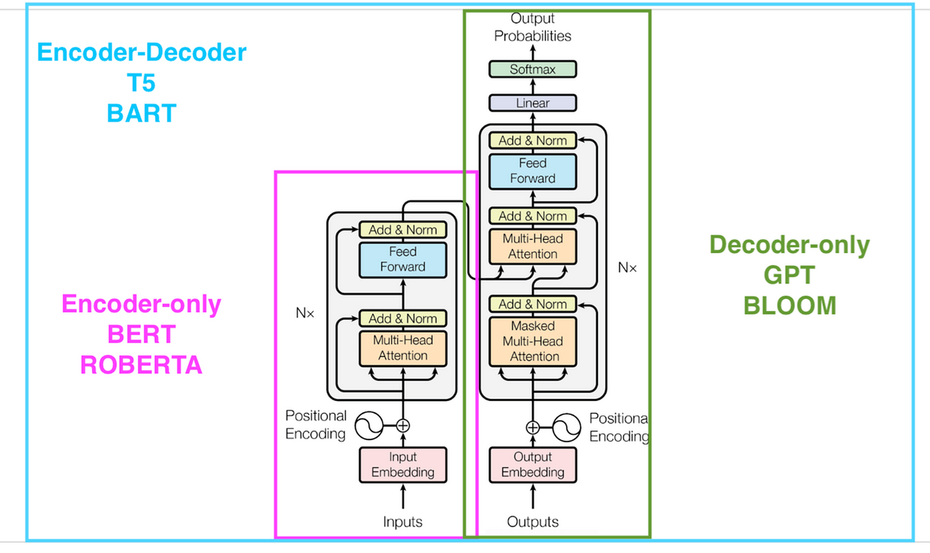


BART Representation
The BART Model
(Bidirectional and Auto-Regressive Transformer)
🔹 1. Encoder (Understanding the Findings)
Breaks down MRI findings into tokens.
Captures bidirectional context (reads left + right).
Learns relationships between medical terms (e.g., disc bulge, thecal sac).
🔹 2. Latent Representation
Encoded text converted into dense vector form.
Acts as the “compressed knowledge” of the input.
🔹 3. Decoder (Generating Impressions)
Uses auto-regressive generation (one token at a time).
Attends to encoder output + already generated words.
Produces concise, clinically meaningful impressions.
🔹 4. Pretraining & Fine-tuning
BART is pretrained as a denoising autoencoder (input text is corrupted → model learns to reconstruct).
We fine-tuned it on radiology datasets (BioBART variant) to adapt to MRI medical text.
Bart encoder -decoder for model training

Slide 6
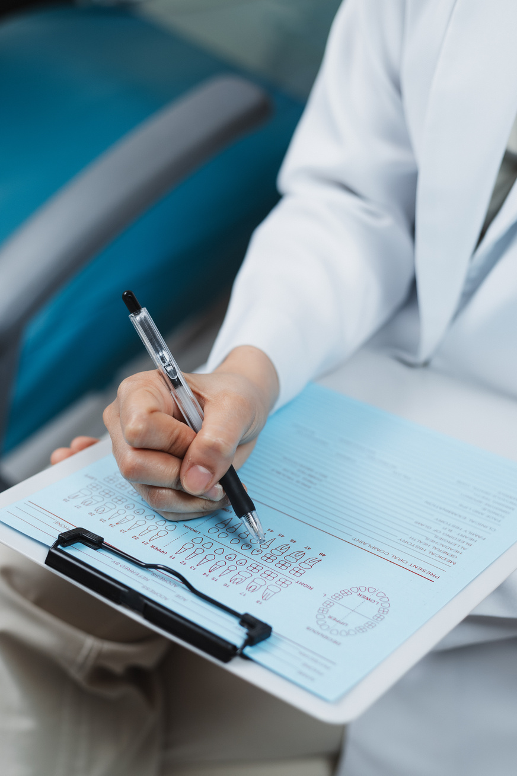
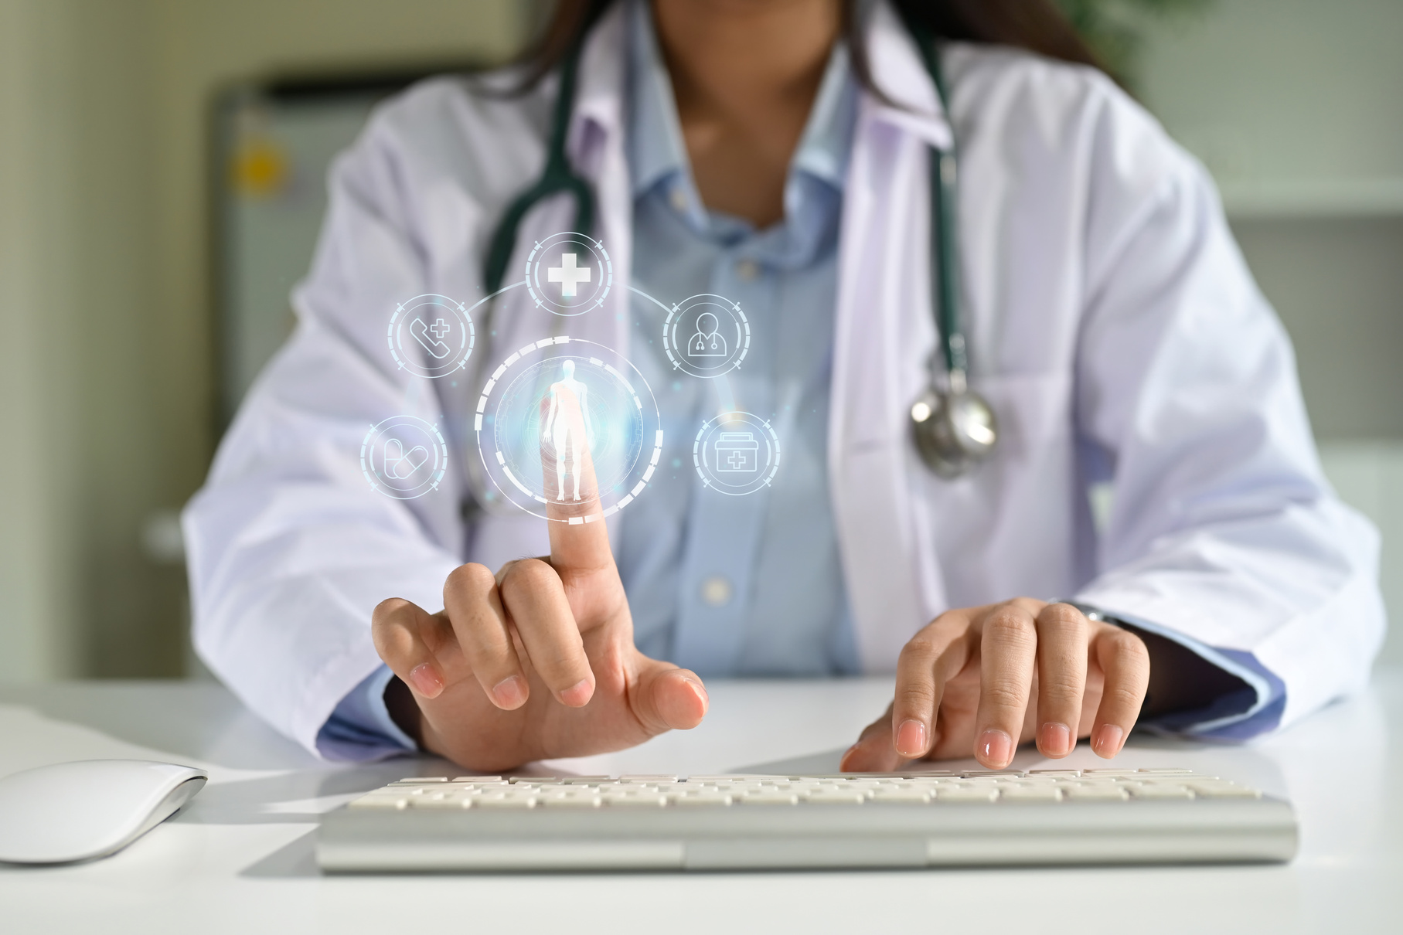
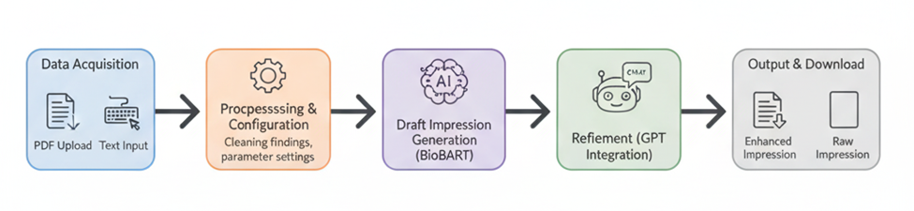
Workig of our project
User Interface (Streamlit)
Input the Text by Pasting or PDF Upload)
To validate whether the input findings either text ot loaded from pdf is of MRI only.
Generate raw impression from trained BioBART model fine tune on mimic iv
enhance impression with gpt with GPT-4
Output (Raw Impression, Enhanced Impression)
Download Enhanced impression
Hugging Face Spaces (for deployment)

Slide 7
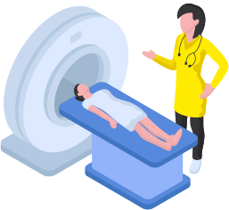
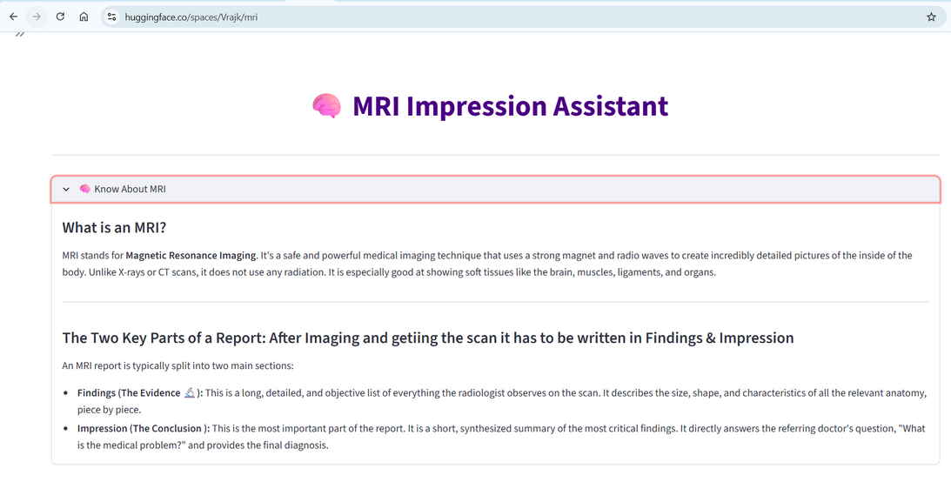
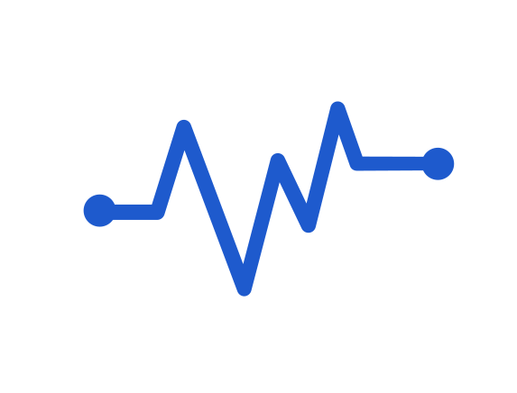
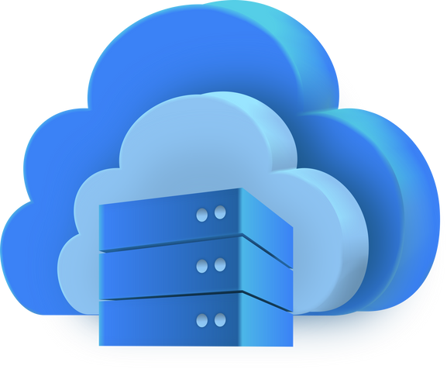
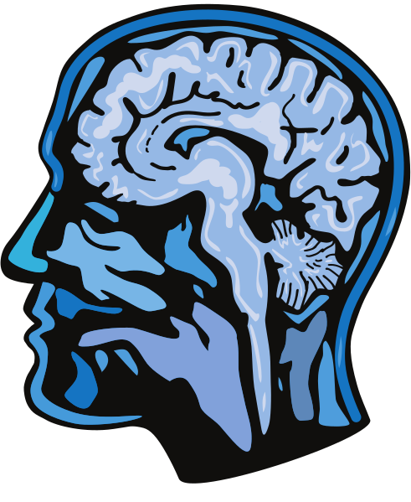
Technical Achievements & Implementation Details
Domain-Specific Fine-tuning: BioBART training specialized for MRI reports using MIMIC-IV Radiology.
Cloud Agnostic LLM Integration: Seamlessly integrated Azure OpenAI for advanced enhancement to get proper report like a radiologist.
Efficient PDF Text Extraction: Using unstructured.io for robust data input from reports.
Scalable Deployment: Hosted on Hugging Face Spaces for public access.
Secure API Handling: Environment variables and Hugging Face secrets for API keys.

Slide 8
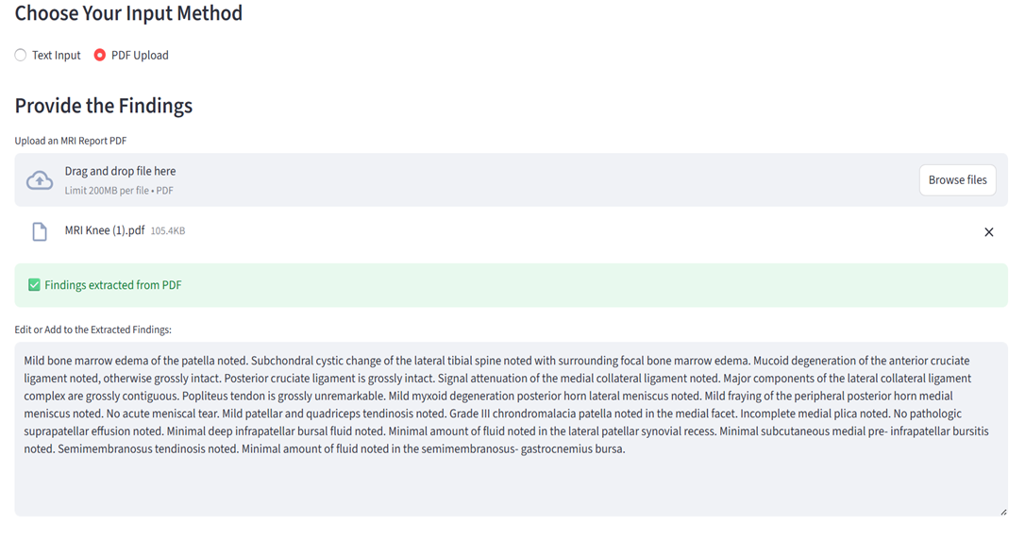
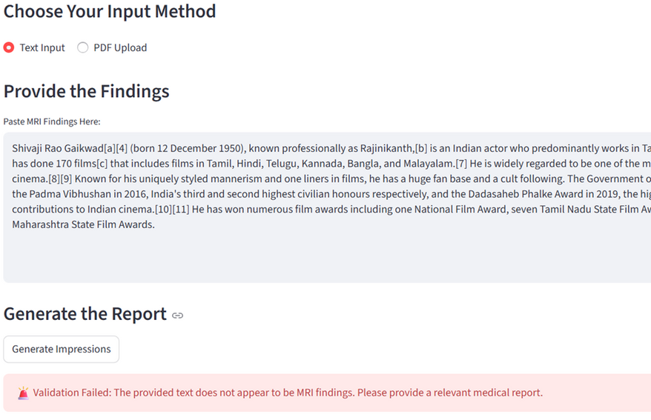



Testing & validation
Different parts of the system were tested separately (PDF extraction, input validation, impression generation).
End-to-end tests were done by giving actual MRI text and checking the generated impressions.
Conducted end-to-end user flow tests on the Streamlit app for UI, input methods (text, PDF), and output quality.

Slide 9
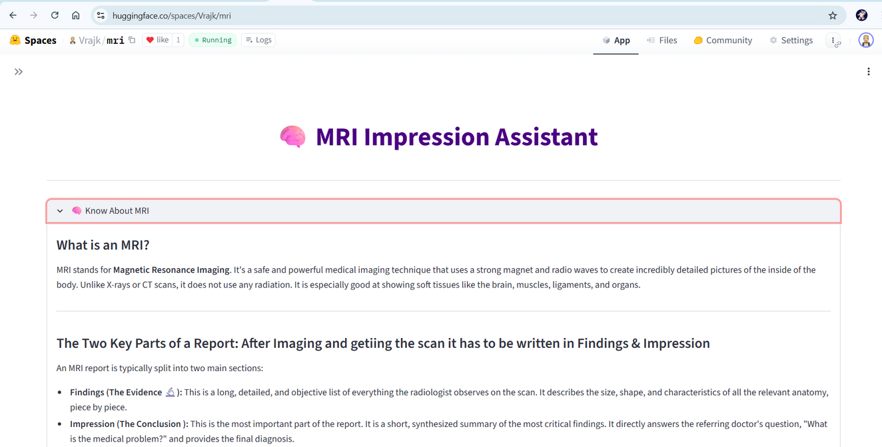

Live & Operational: Deployment on Hugging Face Spaces
Platform: Hugging Face Spaces (Streamlit SDK) for easy, public cloud deployment.
Hybrid Hosting: Application code in Space, BioBART model on Hugging Face Model Hub.
Monitoring: Built-in Hugging Face Analytics (CPU, Memory) and Logs for real-time health checks.
Maintenance: Plan for dependency updates, model retraining, and security patches.
Live URL: https://huggingface.co/spaces/Vrajk/mri

Slide 10
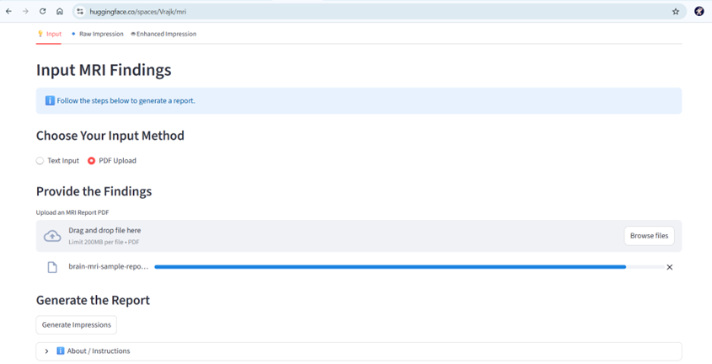
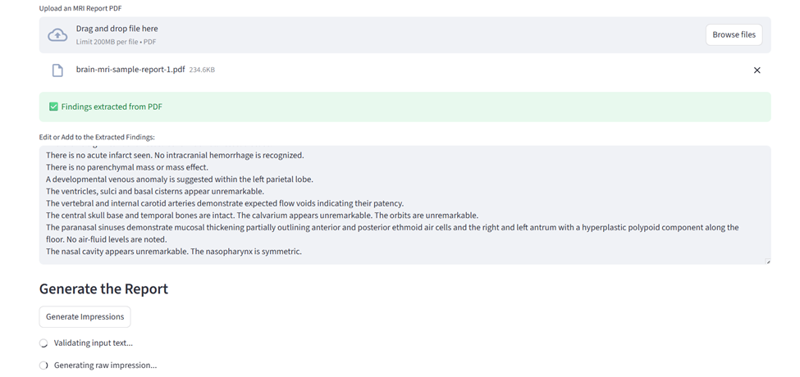


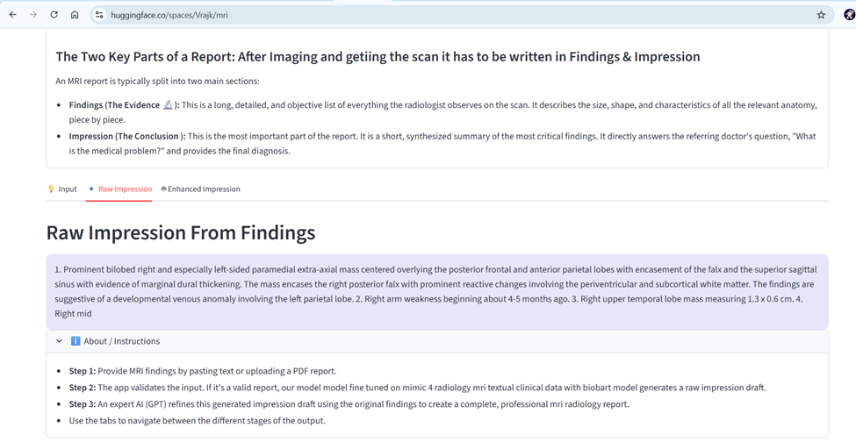
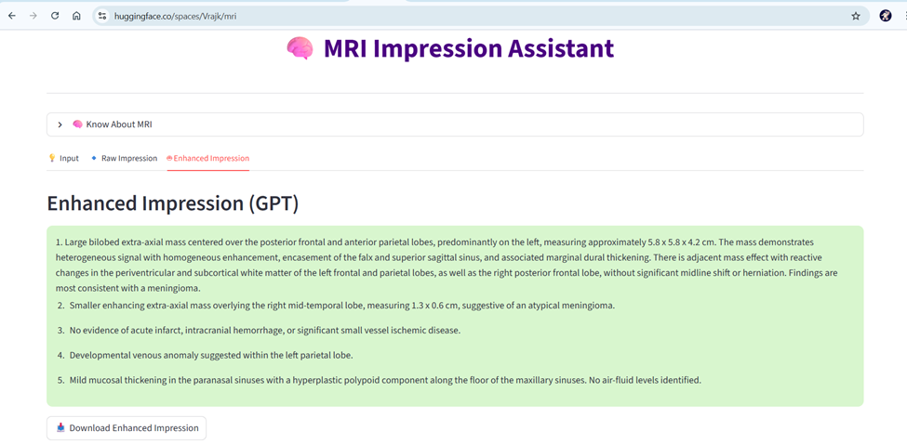



Slide 11
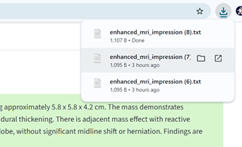
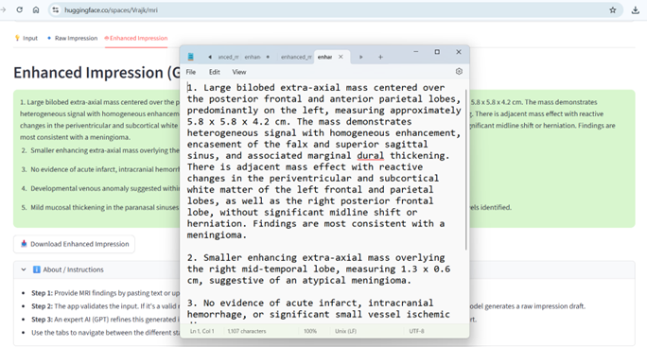
Downloadabale in text

Slide 12
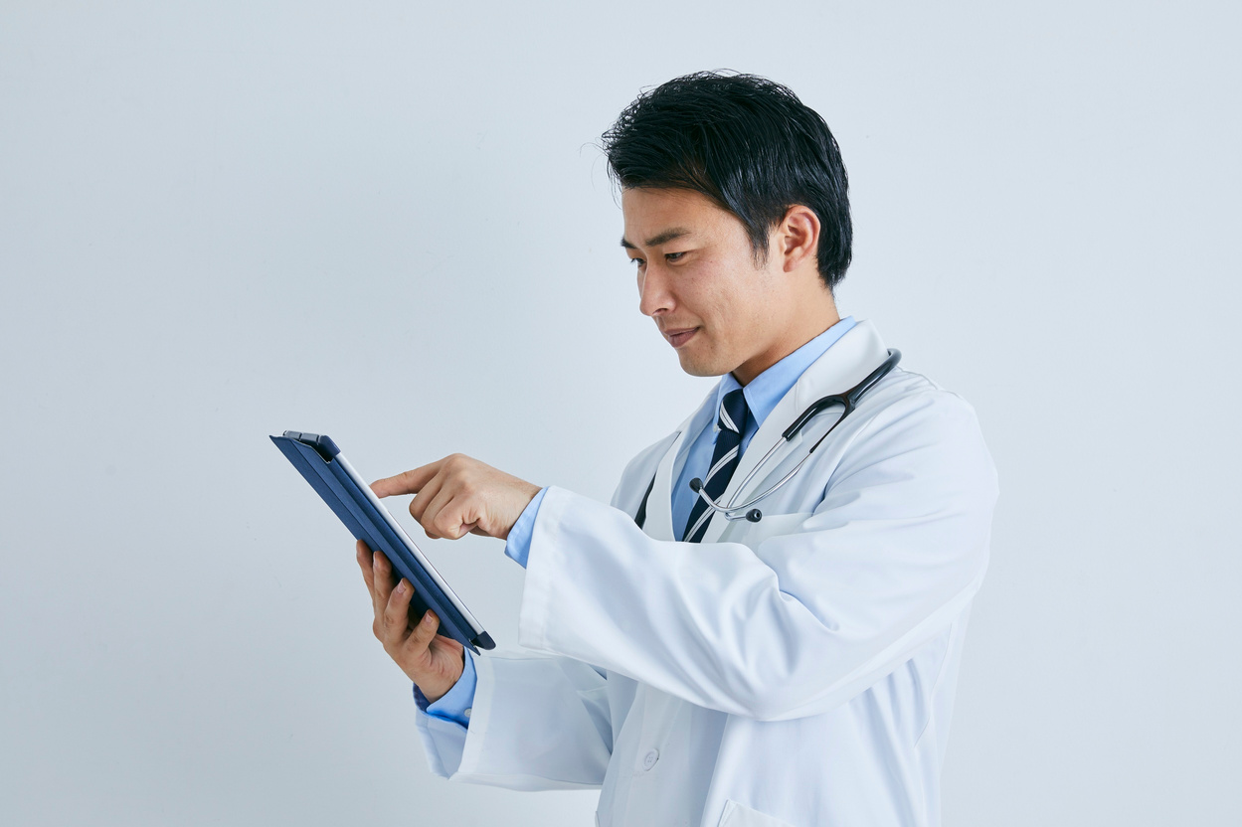
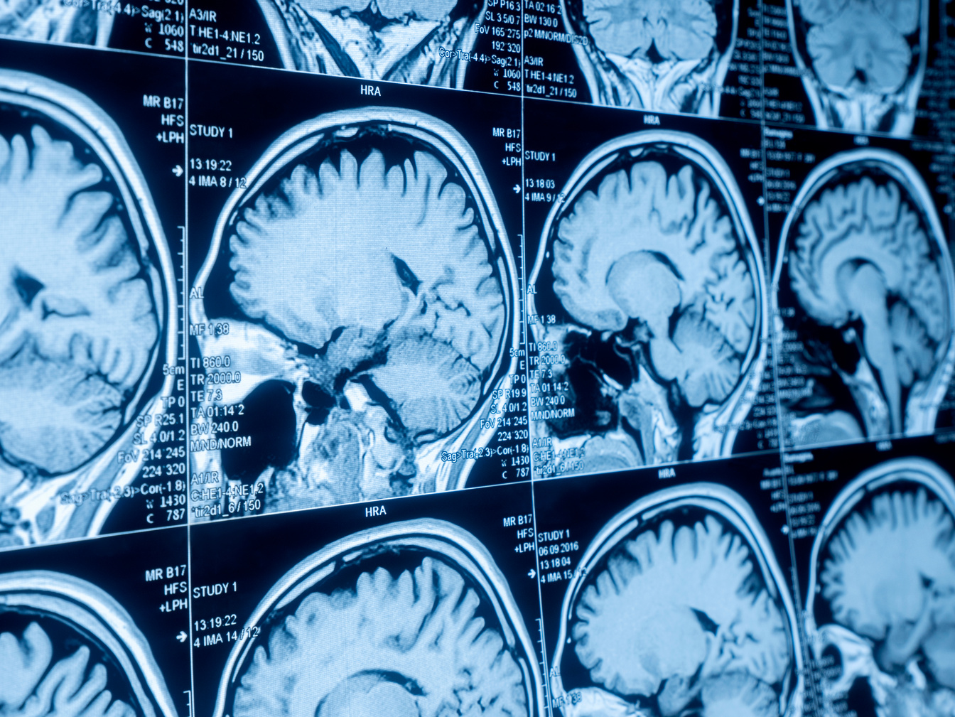
Impact & Future Work
Contribution to ICT/Radiology:
Pioneering a hybrid AI approach for complex clinical text generation.
Reducing radiologist workload, improving efficiency and report consistency.
Setting a precedent for combining specialized models with powerful LLMs for focused tasks.
Potential Impact:
Faster diagnosis, improved documentation quality, and reduced burnout for medical professionals.
Future Work:
Work with images of mri to generate findings as well as impressions both.
Expanding to other medical imaging modalities (e.g., CT, X-ray).
Incorporating user feedback loops for continuous model improvement.
Discussion With radiologist suggested that it needs more details so that it can give you impressions close to what radiologist give and also suggested to work on patient history as well the impression are base on patient history , the location form where they belong to any medication being consumed .

Slide 13
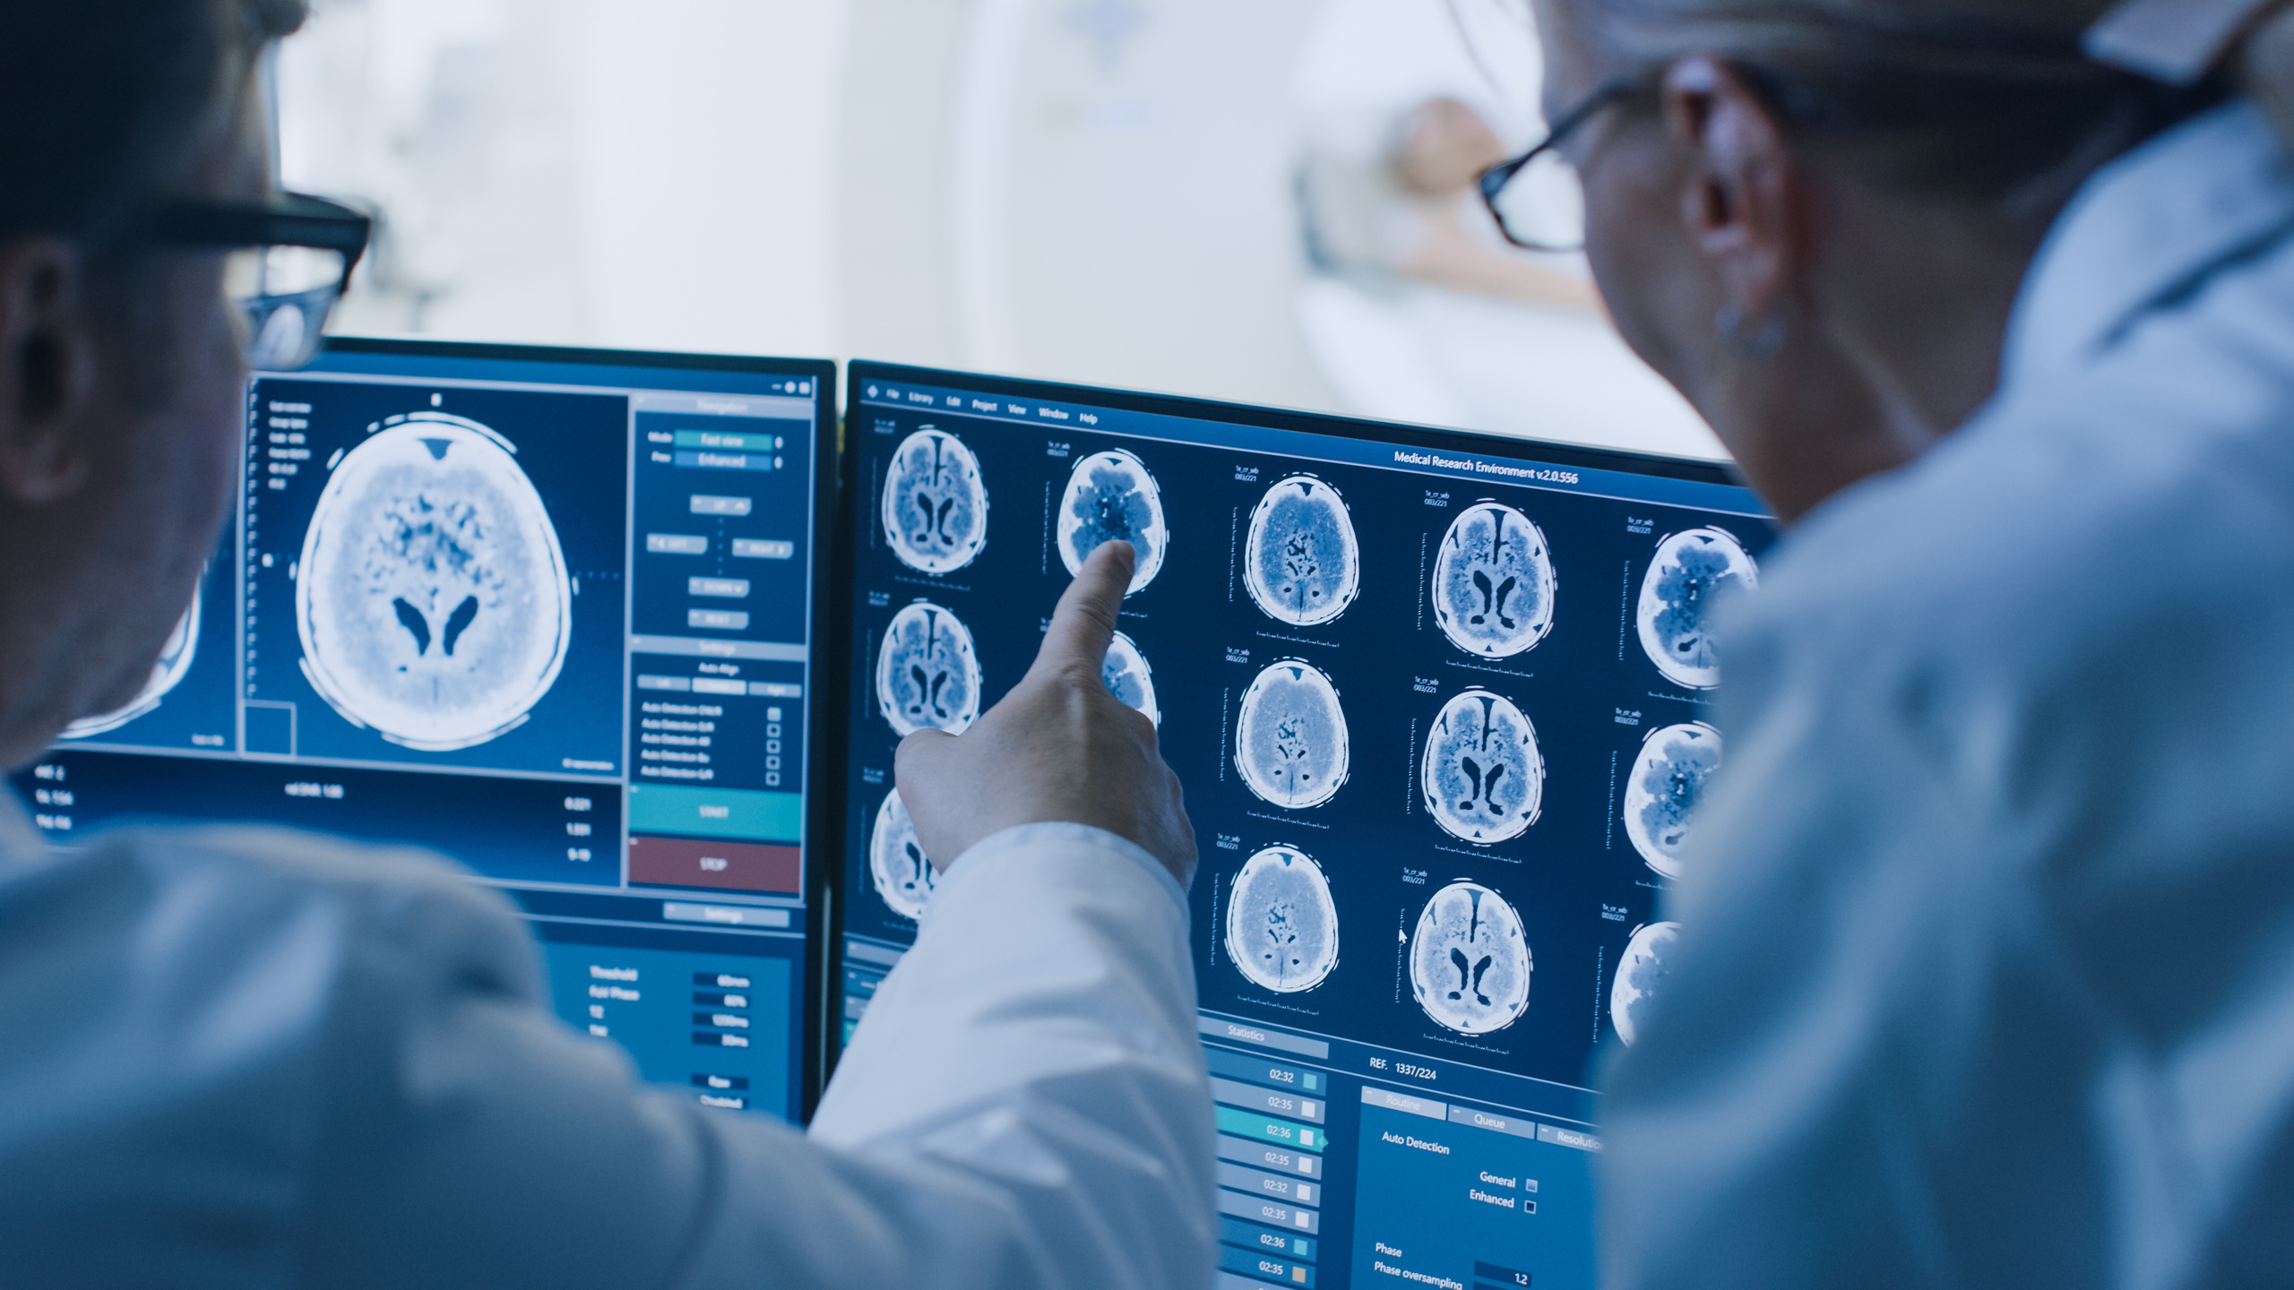
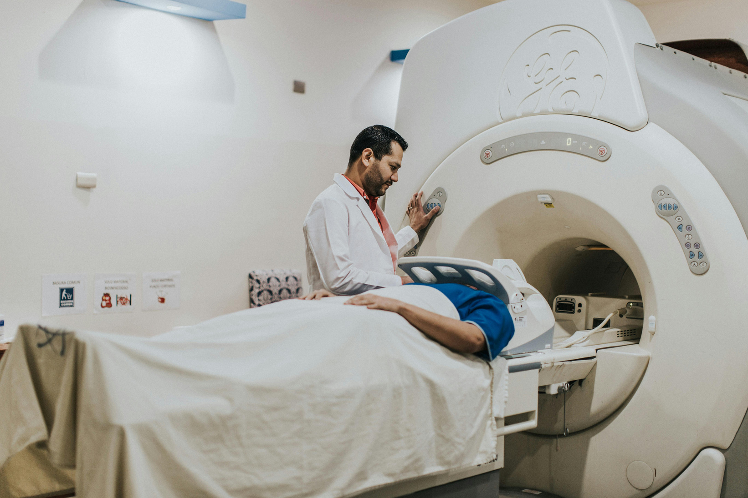
Contact
Thank
You
Contact: vrajnandwana26@gmail.com
Model live link: https://huggingface.co/Vrajk/mri-impressions/tree/main
Live hosted link:https://huggingface.co/spaces/Vrajk/mri

